Slide 1

Activity Diagram
BIS601
Notes:
NOTE:
To change the image on this slide, select the picture and delete it. Then click the Pictures icon in the placeholder to insert your own image.

Slide 2
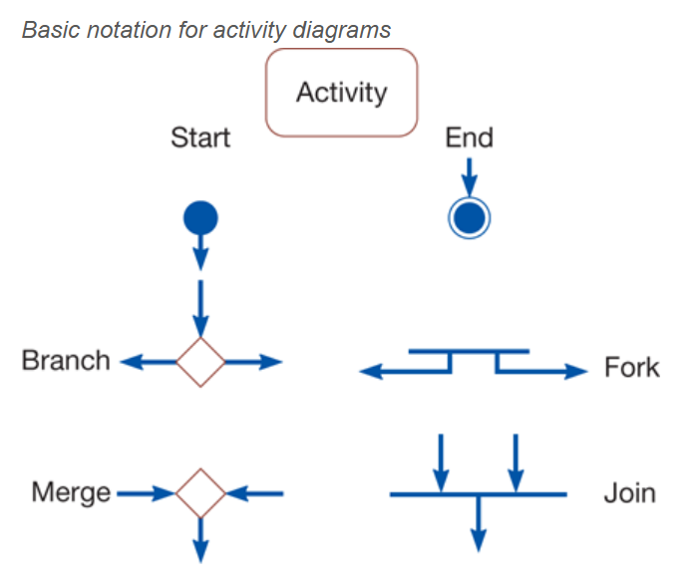

Slide 3
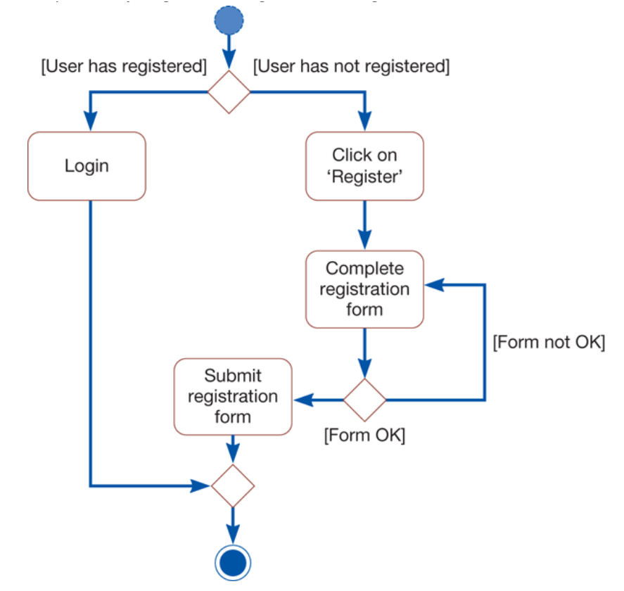

Slide 4
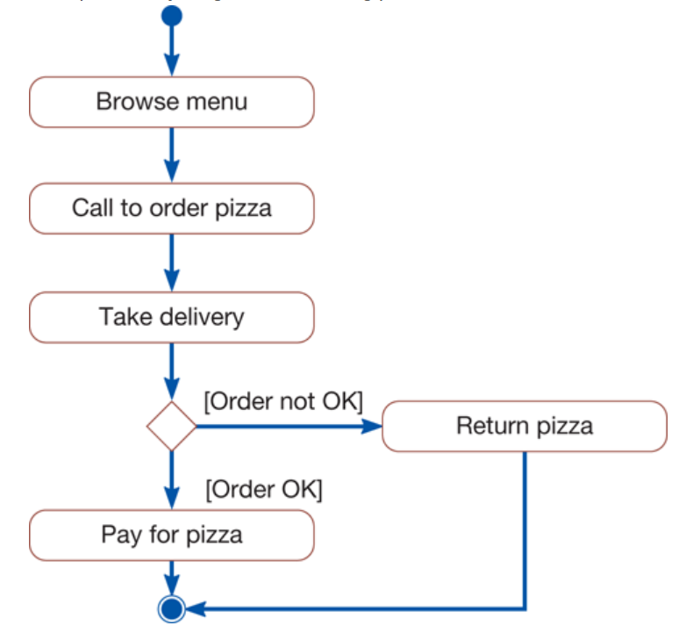

Slide 5
